Slide 1




Team Dakota
V1.0 Team Presentation

Slide 2
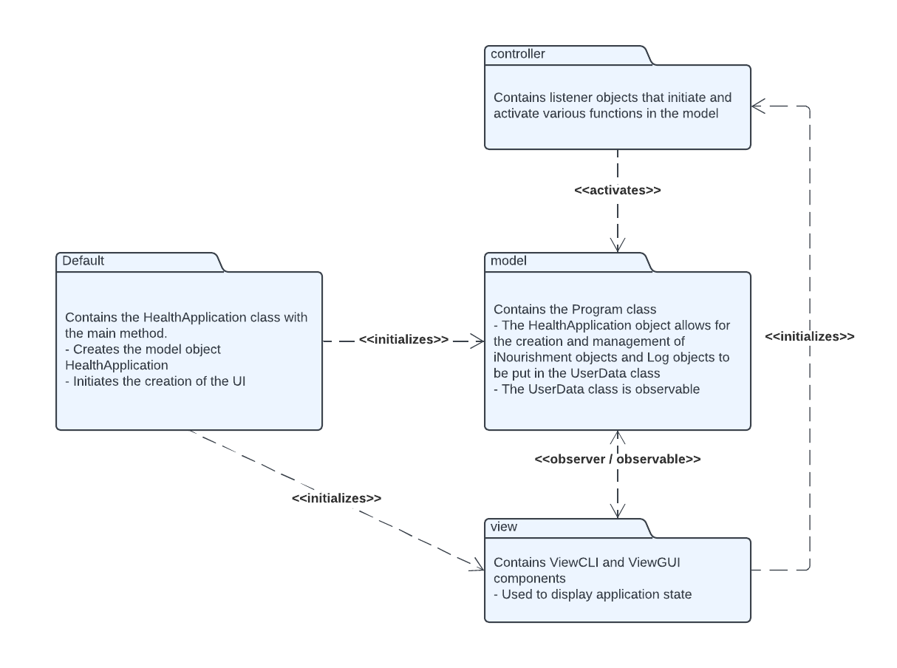
Design Process - MVC Pattern
MVC Architecture, why?
Model
Program
UserData
iNourishment
View
ViewCLI
Controller
FoodAction
LogAction
Notes:
Daniel:
The main design architecture that we have structured out application on in the Model View Controller architecture.
MVC Architecture allows for user interaction without the user directly interacting with the model. This allows for a higher cohesion of subsystems.
Our program’s primary class and the user data is stored in our model package.This package handles all program operations such as log management, food management, file reading, file saving, and nutritional calculations.
The view package contains the CLI that the user interacts with. Eventually it will also include a GUI. This view package observes the model package for any changes in it, and reflects it back to the user through the view.
The view relies on the controller package that contains two classes; FoodAction and LogAction, in which each class has methods for managing food items and log items

Slide 3
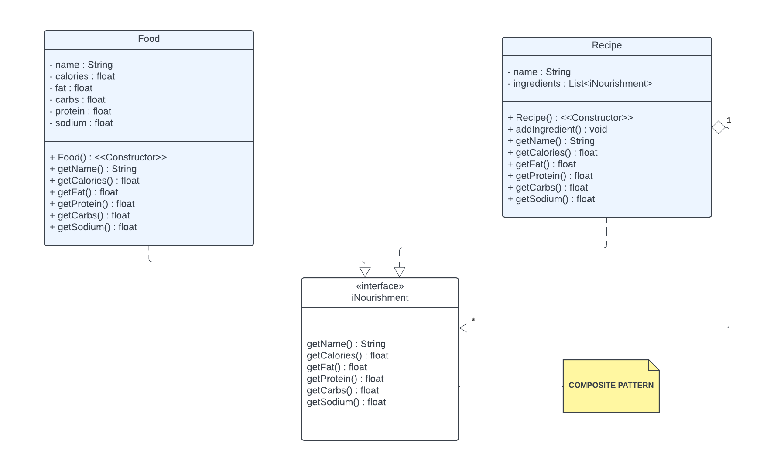
Design Process - Composite Pattern
Component:
iNourishment
Leaf:
Food Class
Composite:
Recipe Class
Notes:
Luke
So of course for this project we will be using a composite pattern in our development to help organize food logs. Composite patterns are ideal for cases where we are out to represent hierarchies of objects, such as things like individual foods and entire recipes.
The component in our design is the iNourishment interface. iNourishment acts as the foundational piece that unifies both individual Food items and Recipe groups by defining a shared set of methods. This interface specifies the basic methods that all iNourishment objects need, like getCalories(), getFat(), and getProtein(). Because both Food and Recipe implement iNourishment, they can be treated in the same way, regardless of whether they're simple items or complex recipes. This allows our code to handle both types of objects in a consistent manner, making it easy to build flexible, hierarchical structures.
In this pattern, the leaf is the Food class, and the composite is the Recipe class. The Food class represents individual items, such as a banana, with attributes for calories, fat, carbs, protein, and sodium. The Recipe class, on the other hand, acts as a composite by holding a list of iNourishment items, which could include individual Food objects or even other Recipe objects. This means we can represent complex meals, like a sandwich made of multiple ingredients, as a single Recipe that can then be nested within other recipes if needed.
By using the Composite pattern, we treat both Food and Recipe classes as iNourishment, making it easy to calculate total nutritional values at any level. For example, when logging a recipe with multiple ingredients, Recipe calculates its total calories and nutritional values by summing up each ingredient's values. This approach keeps our code organized and adaptable, so users can log both individual items and recipes seamlessly, reflecting their real-world dietary habits.

Slide 4
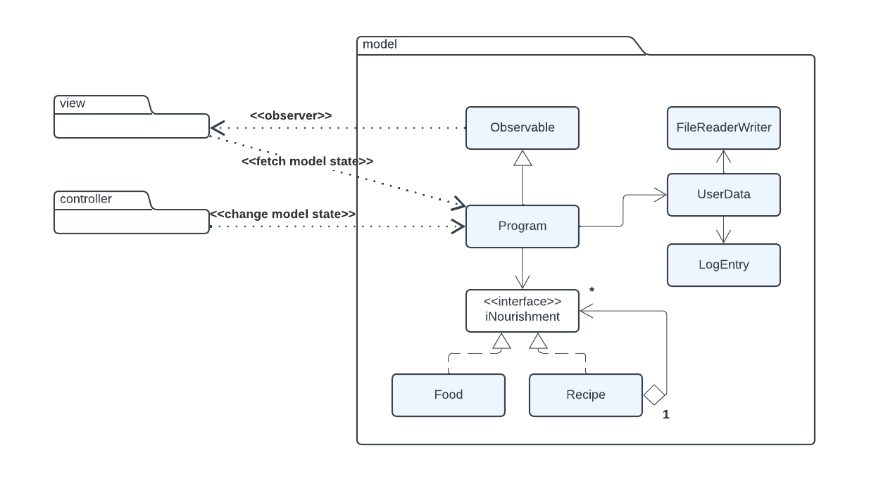
Design Process
Observer Pattern, why?
Notes:
Leeon: Hello, I’m Leeon, the quality coordinator of Team Dakota. The Observer pattern is one way design that approach that creates one-way communication from model to view, keeping the UI in sync with the data model. In our application, the Program class in the model acts as observable. It tracks data changes and notify other components like Food, Recipe, UserData, and LogEntry, specifically the view. The view is the observer, watching for updates from model. When model changes, it notify updates in the view without the view need to access or modify data. The controller interacts with the model, modifying data like adding food item. The controller calls appropriate method in program which triggers updates to the view via the Observer pattern. This approach keeps the code modulating and separate concerns effectivity. The view only allow what can display and what isn’t like handing the model’s logic, making it more easier to maintain or extend. It helps because it enhancing user experience and keeping the UI responsive.
ASL: Observer pattern is one way design that approach that makes one way communication from model to view, keeping UI sync with data model. In our application, program class in model acts as observable. It tracks data change and inform other group (components) like food, recipe, UserData, and LogEntry, specific the view. View is observer, watching updates from model. When model changes, modifying data like adding food item. The controller calls appropriate method in program that start updates to view from observer pattern. This approach keeps code modulating and separate concern effect. View only allow what can display and what not handing model’s logic, making it more easier to maintain or extend. It helps because it increasing user experience and keeping UI response.

Slide 5
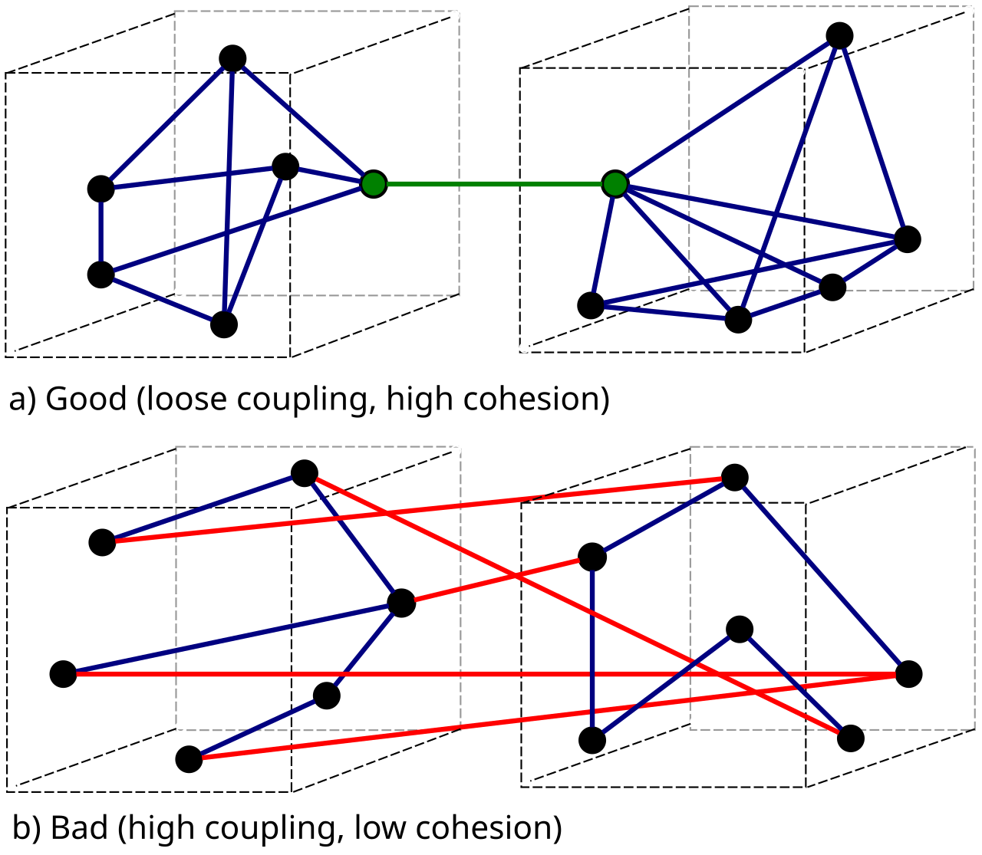
Coupling and Cohesion
High Cohesion - MVC model helps cohesion by separating the packages - Each class performs a specific task and is responsible for that one task - Program class centralizes all of the data management
Low Coupling - UI pulls directly from foodAction and logAction controllers - UI depends on the controllers to function - If the structure of other classes change, minimal changes are required for the UI
Notes:
Kyle

Slide 6
Challenges & Successes
Challenges
Design Document / Sequence
Skeleton
Successes
Subsystem Structure
Proper Design Patterns
High Cohesion
Notes:
Sahand -
Our First challenge was completing Design Document, we struggled by deciding which was need require and the most challenge we struggle was Sequence Diagram, MVC, Composite, Observer Pattern and Subsystem. Those are the challenge we had and didn’t had enough information to start until we took a look at some of the team during the class time and look on their design documents and gave us idea. We perfectly did create a good Subsystem structure, all of class program, pattern usage and MVC, Composite and Observer Pattern and successfully did good sequence diagram but we should be careful next time by cropping the sequence diagram picture and put on design document more professionally. Overall We successfully did it and was great. REVISE -> I’m Design Coordinator for team dakota -> Our first challenge was completing the Design Document; we struggled to decide which section was necessary, and the most challenging area we struggled with was Sequence Diagram, MVC. We had a decent understanding of what we needed to implement, but when we worked with the other groups in our class, they gave us a better understanding of the requirements of the Design Document and it’s sequence diagrams. On top of that, it also showed us how other people implemented their Model View Controller architecture. We hoped the sequence diagram would be easy. However, it wasn't as easy, so we decided to assign two members on a sequence diagram. We created an excellent Subsystem structure, all of the class program, pattern usage, Composite, and Observer Patterns. Overall, We were able to overcome Design Document challenge, and it was great. Our 2nd biggest challenge was Skeleton. We had some problems with our code at first and we had to make sure all of the value was consistent and sense to match the design document. We had team meeting and reassure the code was perfectly make sense and we successfully was able to build skeleton without any problem We had a decent understanding of what we needed to implement, but when we worked with the other groups in our class, they gave us a better understanding of the requirements of the Design Document and it’s sequence diagrams. On top of that, it also showed us how other people implemented their Model View Controller architecture. We hoped the sequence diagram would be easy. However, it wasn't as easy, so we decided to assign two members on a sequence diagram.

Slide 7

Questions and Demo!

